Slide 1

Module 1: Using Dependency Tracking
0/5
Analytics: Advanced Server Architect
Notes:
Time: Lecture: <n – n> minutes; Labs: <n – n> minutes
Intent: <What is the instructional goal of the module>
Flow: < Describe at a high level the overall flow of the module>.
Key Terms: <List terms the instructor should be familiar with in order to teach this module>
<Term>
<Term>
<Term>
<Term>

Slide 2
Module Objectives
After completing this module you will be able to:
  Identify dependency relationships among elements in the repository
  Explain the significance of dependency tracking
Why you need to know:
  Assists users in making informed changes to the repository file
  Allows multiple groups to identify how changes to repository objects might impact other projects
Notes:
Each objective and “why you need to know” should be stated aloud.

Slide 3
Business Challenge
Analytics metadata is not static
  Multiple projects may be in progress
  Objects may be changing
  Source metadata such as database schema may be changing
Changes to one object may impact many others
  Developers on different projects need to know whether their changes will impact other projects
  Business analysts need to know object relationships to create their designs
Tracking object dependencies manually is likely to introduce errors

Slide 4
Business Solutions
Use Siebel Analytics’ Display Related functionality to identify related objects in Analytics metadata
  Provides a list of directly related objects, but their relationships must be tracked manually
    Does not display relationships between related objects
  Developers must have access to the repository
Use Siebel Analytics’ Dependency Tracking Utility to track dependencies in Analytics metadata
  Provides a list of related objects and their relationships
  Developers do not need access to the repository
    For example, business or data analysts seeking to understand data lineage

Slide 5
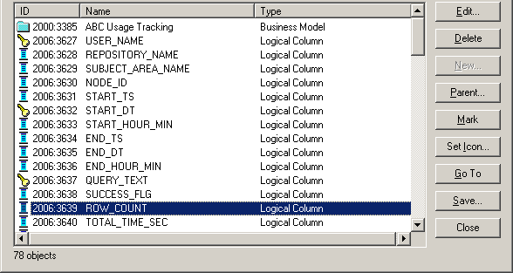
Display Related Functionality
Performs queries against the repository to return objects directly related to an object
  Does not track any other relationships
  Does not provide enough information to do detailed analysis
  Provides a quick list of what objects are related to a given object
Display Related function queries the repository and returns ID, Name, and Type of all related objects

Slide 6
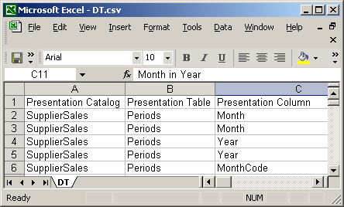
Siebel Analytics Dependency Tracking Utility
Extracts Siebel Analytics metadata to a flat file that can be loaded into Microsoft Excel, a Relational Database Management System (RDBMS), or another system
  Query the resulting file to answer questions such as, “If I delete physical column X, what logical columns will be affected?" or "How many places in the business model refer to the physical table W_SRVREQ_F?”
Dependency tracking utility exports data so it can be examined using any program that can read delimited text files
Notes:
Engagement Question: Who would implement it?
Answer: Siebel Architect who configures the Analytics Metadata
Engagement Question: When is this information gathered?
Answer: This information would be gathered during the Discover stage and designed during the Design stage of a project.
Engagement Question: Is this included in the Siebel Analytics Vanilla / Out of the Box product?
Answer: Yes – as an example, check out the Activities Presentation Catalog Subject Area.

Slide 7
Advantages of Dependency Tracking Utility
Exported metadata:
  Includes a row for each relationship, providing much greater detail than the Display Related function
  Includes columns for all layers of metadata, including:
    Presentation Catalog, Table, and Column
    Business Model, Logical Table, and Logical Column
    Database, Physical Catalog, Schema, Table, Alias, and Column
  Is available to everyone
    Analysts do not need access to Siebel Analytics Administration Tool
  Can be analyzed using Siebel Analytics
    Provides familiar user interface for analysts

Slide 8
Steps to Perform Dependency Tracking
0/4
1. Export Analytics Metadata
2. Import Analytics Metadata to Siebel Analytics
3. Configure Presentation Catalog
4. Query Analytics Metadata
Notes:
This is a structuring slide for <insert what will be discussed>. Do not teach the steps or concepts here because the following slides cover them in detail. Provide a high level description of what will be discussed.

Slide 9
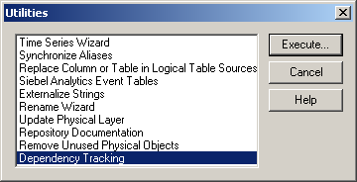
1. Export Analytics Metadata
1/4
Use Dependency Tracking utility to export data
  File format can be comma-delimited, tab-delimited, or XML
  Caveat: This file excludes any information about repository variables
Examine file using Microsoft Excel or RDBMS to verify export
  Caveat: Microsoft Excel only allows data sets of 65,536 rows, so it may be necessary to create and export a subset of the repository data
Select Tools > Utilities to bring up Utilities dialog box
Select Dependency Tracking and click Execute to export metadata

Slide 10
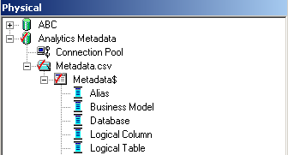
2. Import Analytics Metadata to Siebel Analytics
2/4
Add a primary key column to the exported file to support table relationships
  Best practice: Use row number as primary key
Create ODBC connection for the file
  Recommended practice: Convert delimited text file to Microsoft Excel spreadsheet for easier import
Import data as a physical source in Siebel Analytics using ODBC connection
Import metadata as a physical source in Siebel Analytics

Slide 11
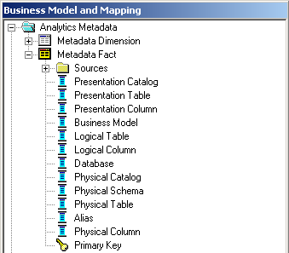
3. Configure Presentation Catalog
3/4
Create both a dimension and a fact table representing the metadata table
  Every business model requires at least one dimension table and one fact table
  Use the primary key to support the join
Dimension and fact tables both map to metadata table

Slide 12
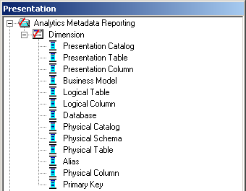
3. Configure Presentation Catalog Continued
3/4
Add the dimension table to the Presentation layer to support querying for object relationships

Slide 13
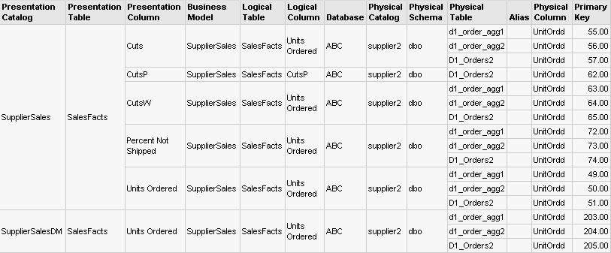
4. Query Analytics Metadata
4/4
Use Siebel Answers to examine relationships between objects
  For example, a query where “Physical Column = UnitOrdd”:
The SupplierSales and SupplierSalesDM presentation catalogs reference the UnitOrdd physical column
The Units Ordered and CutsP logical columns within the SupplierSales presentation catalog reference the UnitOrdd physical column

Slide 14
Summary
This module showed you how to:
  Identify dependency relationships among elements in the repository
  Explain the significance of dependency tracking
Notes:
Review Question: <Question>
Answer: <Answer>

Slide 15
Lab
In the lab you will:
  Use the Dependency Tracking utility to export Analytics metadata to a flat file
  Analyze dependency relationships using Siebel Answers
Notes:
Labs and Troubleshooting:
<Summarize the tasks the students will perform in this lab. Suggest specific guidance the instructor may provide if necessary to help the students complete the lab and avoid trouble spots.>

